Slide 1
Data Mining:
Concepts and Techniques
— Slides for Textbook —
— Chapter 6 —
©Jiawei Han and Micheline Kamber
Intelligent Database Systems Research Lab
School of Computing Science
Simon Fraser University, Canada
http://www.cs.sfu.ca
Data Mining: Concepts and Techniques

Slide 2
Chapter 6: Mining Association Rules in Large Databases
Association rule mining
Mining single-dimensional Boolean association rules from transactional databases
Mining multilevel association rules from transactional databases
Mining multidimensional association rules from transactional databases and data warehouse
From association mining to correlation analysis
Constraint-based association mining
Summary
Data Mining: Concepts and Techniques

Slide 3
What Is Association Mining?
Association rule mining:
  Finding frequent patterns, associations, correlations, or causal structures among sets of items or objects in transaction databases, relational databases, and other information repositories.
Applications:
  Basket data analysis, cross-marketing, catalog design, loss-leader analysis, clustering, classification, etc.
Data Mining: Concepts and Techniques

Slide 4
Examples.
Rule form: “Body → Ηead [support, confidence]”.
buys(x, “computers”) → buys(x, financial_mgmt_s/w”)
[ 2%, 60%]
major(x, “CS”) ^ takes(x, “DB”) → grade(x, “A”)
[1%, 75%]

Slide 5
Association Rule: Basic Concepts
Given: (1) database of transactions, (2) each transaction is a list of items (purchased by a customer in a visit)
Find: all rules that correlate the presence of one set of items with that of another set of items
  E.g., 98% of people who purchase tires and auto accessories also get automotive services done
Applications
  * ⇒ Maintenance Agreement (What the store should do to boost Maintenance Agreement sales)
  Home Electronics ⇒ * (What other products should the store stocks up?)
  Attached mailing in direct marketing
Data Mining: Concepts and Techniques

Slide 6
Rule Measures: Support and Confidence
Customer
buys both
Customer
Buys computer
Find all the rules X & Y ⇒ Z with minimum confidence and support
  support, s, probability that a transaction contains
  {X Y  Z}
  confidence, c, conditional probability that a transaction having {X Y} also contains Z
Customer
Buys financial mgmt s/w
Data Mining: Concepts and Techniques

Slide 7
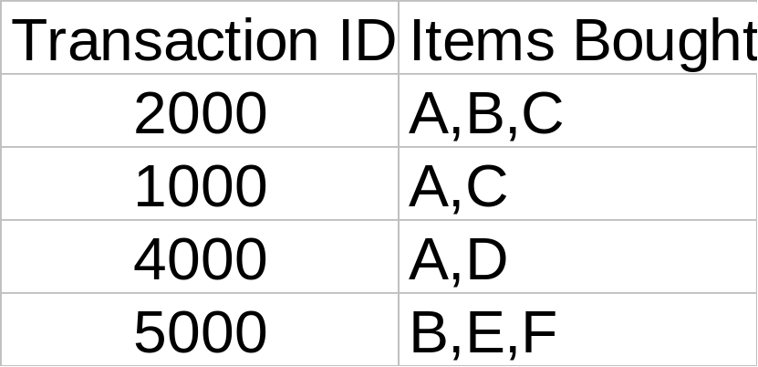
Let minimum support 50%, and minimum confidence 50%, we have
  A ⇒ C (50%, 66.6%)
  C ⇒ A (50%, 100%)

Slide 8
Association Rule Mining: A Road Map
Boolean vs. quantitative associations (Based on the types of values handled)
  buys(x, “SQLServer”) ^ buys(x, “DMBook”) → buys(x, “DBMiner”) [0.2%, 60%]
  age(x, “30..39”) ^ income(x, “42..48K”) → buys(x, “PC”) [1%, 75%]
Single dimension vs. multiple dimensional associations (see ex. Above)
Single level vs. multiple-level analysis
  Items brought are referenced at different levels of abstraction.
  age(x, “30..39”) => buys(x, “laptop computer”)
  age(x, “30..39”) => buys(x, “computer”)
Data Mining: Concepts and Techniques

Slide 9
Chapter 6: Mining Association Rules in Large Databases
Association rule mining
Mining single-dimensional Boolean association rules from transactional databases
Mining multilevel association rules from transactional databases
Mining multidimensional association rules from transactional databases and data warehouse
From association mining to correlation analysis
Constraint-based association mining
Summary
Data Mining: Concepts and Techniques

Slide 10
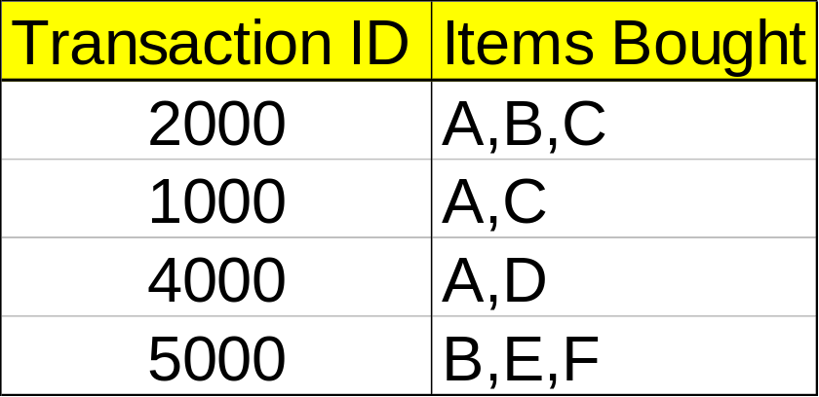
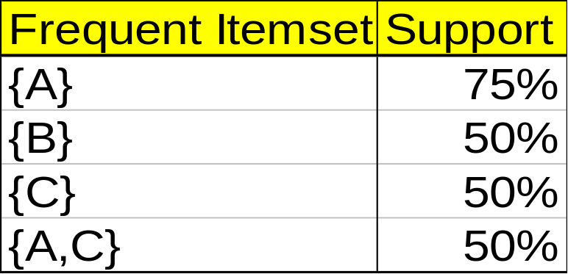
Mining Association Rules—An Example
Min. support 50%
Min. confidence 50%
For rule A ⇒ C:
  support = support({A C}) = 50%
  confidence = support({A C})/support({A}) = 66.6%
The Apriori principle:
  Any subset of a frequent itemset must be frequent
Data Mining: Concepts and Techniques

Slide 11
Mining Frequent Itemsets: the Key Step
Find the frequent itemsets: the sets of items that have minimum support
  A subset of a frequent itemset must also be a frequent itemset
    i.e., if {AB} is a frequent itemset, both {A} and {B} should be a frequent itemset
  Iteratively find frequent itemsets with cardinality from 1 to k (k-itemset)
Use the frequent itemsets to generate association rules.
Data Mining: Concepts and Techniques

Slide 12
The Apriori Algorithm
Join Step: C_{k} is generated by joining L_{k-1}with itself
Prune Step: Any (k-1)-itemset that is not frequent cannot be a subset of a frequent k-itemset
Pseudo-code:
    C_{k}: Candidate itemset of size k
    L_{k} : frequent itemset of size k
    L₁ = {frequent items};
    for (k = 1; L_{k} !=∅; k++) do begin
    C_{k+1} = candidates generated from L_{k};
    for each transaction t in database do
      increment the count of all candidates in C_{k+1} that are contained in t
    L_{k+1} = candidates in C_{k+1} with min_support
    end
    return ∪_{k} L_{k};
Data Mining: Concepts and Techniques

Slide 13








The Apriori Algorithm — Example
Database D
L₁
C₁
Scan D
C₂
C₂
L₂
Scan D
C₃
Scan D
L₃
Data Mining: Concepts and Techniques

Slide 14
How to Generate Candidates?
Suppose the items in L_{k-1} are listed in an order
Step 1: self-joining L_{k-1}
  insert into C_{k}
  select p.item₁, p.item₂, …, p.item_{k-1}, q.item_{k-1}
  from L_{k-1} p, L_{k-1} q
  where p.item₁=q.item₁, …, p.item_{k-2}=q.item_{k-2}, p.item_{k-1} < q.item_{k-1}
Step 2: pruning
  forall itemsets c in C_{k} do
    forall (k-1)-subsets s of c do
      if (s is not in L_{k-1}) then delete c from C_{k}
Data Mining: Concepts and Techniques

Slide 15
How to Count Supports of Candidates?
Why counting supports of candidates a problem?
  The total number of candidates can be very huge
  One transaction may contain many candidates
Method:
  Candidate itemsets are stored in a hash-tree
  Leaf node of hash-tree contains a list of itemsets and counts
  Interior node contains a hash table
  Subset function: finds all the candidates contained in a transaction
Data Mining: Concepts and Techniques

Slide 16
Example of Generating Candidates
L₃={abc, abd, acd, ace, bcd}
Self-joining: L₃*L₃
  abcd from abc and abd
  acde from acd and ace
Pruning:
  acde is removed because ade is not in L₃
C₄={abcd}
Data Mining: Concepts and Techniques

Slide 17
Methods to Improve Apriori’s Efficiency
Hash-based itemset counting: A k-itemset whose corresponding hashing bucket count is below the threshold cannot be frequent
Transaction reduction: A transaction that does not contain any frequent k-itemset is useless in subsequent scans
Partitioning: Any itemset that is potentially frequent in DB must be frequent in at least one of the partitions of DB
Sampling: mining on a subset of given data, lower support threshold + a method to determine the completeness
Dynamic itemset counting: add new candidate itemsets only when all of their subsets are estimated to be frequent
Data Mining: Concepts and Techniques

Slide 18
Is Apriori Fast Enough? — Performance Bottlenecks
The core of the Apriori algorithm:
  Use frequent (k – 1)-itemsets to generate candidate frequent k-itemsets
  Use database scan and pattern matching to collect counts for the candidate itemsets
The bottleneck of Apriori: candidate generation
  Huge candidate sets:
    10⁴ frequent 1-itemset will generate 10⁷ candidate 2-itemsets
    To discover a frequent pattern of size 100, e.g., {a₁, a₂, …, a₁₀₀}, one needs to generate 2¹⁰⁰ ≈ 10³⁰ candidates.
  Multiple scans of database:
    Needs (n +1 ) scans, n is the length of the longest pattern
Data Mining: Concepts and Techniques

Slide 19
Mining Frequent Patterns Without Candidate Generation
Compress a large database into a compact, Frequent-Pattern tree (FP-tree) structure
  highly condensed, but complete for frequent pattern mining
  avoid costly database scans
Develop an efficient, FP-tree-based frequent pattern mining method
  A divide-and-conquer methodology: decompose mining tasks into smaller ones
  Avoid candidate generation: sub-database test only!
Data Mining: Concepts and Techniques

Slide 20
Construct FP-tree from a Transaction DB
TID Items bought (ordered) frequent items
100 {f, a, c, d, g, i, m, p} {f, c, a, m, p}
200 {a, b, c, f, l, m, o} {f, c, a, b, m}
300 {b, f, h, j, o} {f, b}
400 {b, c, k, s, p} {c, b, p}
500 {a, f, c, e, l, p, m, n} {f, c, a, m, p}
min_support = 0.5
{}
Steps:
Scan DB once, find frequent 1-itemset (single item pattern)
Order frequent items in frequency descending order
Scan DB again, construct FP-tree
Header Table
Item frequency head
f 4
c 4
a 3
b 3
m 3
p 3
f:4
c:1
c:3
b:1
b:1
a:3
p:1
m:2
b:1
Data Mining: Concepts and Techniques
p:2
m:1

Slide 21
Benefits of the FP-tree Structure
Completeness:
  never breaks a long pattern of any transaction
  preserves complete information for frequent pattern mining
Compactness
  reduce irrelevant information—infrequent items are gone
  frequency descending ordering: more frequent items are more likely to be shared
  never be larger than the original database (if not count node-links and counts)
  Example: For Connect-4 DB, compression ratio could be over 100
Data Mining: Concepts and Techniques

Slide 22
Mining Frequent Patterns Using FP-tree
General idea (divide-and-conquer)
  Recursively grow frequent pattern path using the FP-tree
Method
  For each item, construct its conditional pattern-base, and then its conditional FP-tree
  Repeat the process on each newly created conditional FP-tree
  Until the resulting FP-tree is empty, or it contains only one path (single path will generate all the combinations of its sub-paths, each of which is a frequent pattern)
Data Mining: Concepts and Techniques

Slide 23
Major Steps to Mine FP-tree
Construct conditional pattern base for each node in the FP-tree
Construct conditional FP-tree from each conditional pattern-base
Recursively mine conditional FP-trees and grow frequent patterns obtained so far
  If the conditional FP-tree contains a single path, simply enumerate all the patterns
Data Mining: Concepts and Techniques

Slide 24
Step 1: From FP-tree to Conditional Pattern Base
Starting at the frequent header table in the FP-tree
Traverse the FP-tree by following the link of each frequent item
Accumulate all of transformed prefix paths of that item to form a conditional pattern base
Header Table
Item frequency head
f 4
c 4
a 3
b 3
m 3
p 3
{}
Conditional pattern bases
item cond. pattern base
c f:3
a fc:3
b fca:1, f:1, c:1
m fca:2, fcab:1
p fcam:2, cb:1
f:4
c:1
c:3
b:1
b:1
a:3
p:1
m:2
b:1
p:2
m:1
Data Mining: Concepts and Techniques

Slide 25
Properties of FP-tree for Conditional Pattern Base Construction
Node-link property
  For any frequent item a_{i}, all the possible frequent patterns that contain a_{i} can be obtained by following a_{i}'s node-links, starting from a_{i}'s head in the FP-tree header
Prefix path property
  To calculate the frequent patterns for a node a_{i} in a path P, only the prefix sub-path of a_{i} in P need to be accumulated, and its frequency count should carry the same count as node a_{i}.
Data Mining: Concepts and Techniques

Slide 26
Step 2: Construct Conditional FP-tree
For each pattern-base
  Accumulate the count for each item in the base
  Construct the FP-tree for the frequent items of the pattern base
{}
m-conditional pattern base:
  fca:2, fcab:1
Header Table
Item frequency head
f 4
c 4
a 3
b 3
m 3
p 3
f:4
c:1
{}
All frequent patterns concerning m
m,
fm, cm, am,
fcm, fam, cam,
fcam
c:3
b:1
b:1

a:3
p:1
f:3

m:2
b:1
c:3
p:2
m:1
a:3
m-conditional FP-tree
Data Mining: Concepts and Techniques

Slide 27
Mining Frequent Patterns by Creating Conditional Pattern-Bases
Item
Conditional pattern-base
Conditional FP-tree
p
{(fcam:2), (cb:1)}
{(c:3)}|p
m
{(fca:2), (fcab:1)}
{(f:3, c:3, a:3)}|m
b
{(fca:1), (f:1), (c:1)}
Empty
a
{(fc:3)}
{(f:3, c:3)}|a
c
{(f:3)}
{(f:3)}|c
f
Empty
Empty
Data Mining: Concepts and Techniques

Slide 28
Step 3: Recursively mine the conditional FP-tree
{}
{}
Cond. pattern base of “am”: (fc:3)
f:3
c:3
f:3
am-conditional FP-tree
c:3
{}
Cond. pattern base of “cm”: (f:3)
a:3
f:3
m-conditional FP-tree
cm-conditional FP-tree
{}
Cond. pattern base of “cam”: (f:3)
f:3
cam-conditional FP-tree
Data Mining: Concepts and Techniques

Slide 29
Single FP-tree Path Generation
Suppose an FP-tree T has a single path P
The complete set of frequent pattern of T can be generated by enumeration of all the combinations of the sub-paths of P
{}
All frequent patterns concerning m
m,
fm, cm, am,
fcm, fam, cam,
fcam
f:3

c:3
a:3
m-conditional FP-tree
Data Mining: Concepts and Techniques

Slide 30
Principles of Frequent Pattern Growth
Pattern growth property
  Let α be a frequent itemset in DB, B be α's conditional pattern base, and β be an itemset in B. Then α ∪ β is a frequent itemset in DB iff β is frequent in B.
“abcdef ” is a frequent pattern, if and only if
  “abcde ” is a frequent pattern, and
  “f ” is frequent in the set of transactions containing “abcde ”
Data Mining: Concepts and Techniques

Slide 31
Why Is Frequent Pattern Growth Fast?
Our performance study shows
  FP-growth is an order of magnitude faster than Apriori, and is also faster than tree-projection
Reasoning
  No candidate generation, no candidate test
  Use compact data structure
  Eliminate repeated database scan
  Basic operation is counting and FP-tree building
Data Mining: Concepts and Techniques

Slide 32
Chapter 6: Mining Association Rules in Large Databases
Association rule mining
Mining single-dimensional Boolean association rules from transactional databases
Mining multilevel association rules from transactional databases
Mining multidimensional association rules from transactional databases and data warehouse
From association mining to correlation analysis
Constraint-based association mining
Summary
Data Mining: Concepts and Techniques

Slide 33
Multiple-Level Association Rules
all
Items often form hierarchy.
Items at the lower level are expected to have lower support.
Rules regarding itemsets at
appropriate levels could be quite useful.
Transaction database can be encoded based on dimensions and levels
We can explore shared multi-level mining
computer
printer
desktop
laptop
color
b/w
dell
HP
Data Mining: Concepts and Techniques

Slide 34
A concept Hierarchy
all
computer
printer
desktop
laptop
color
b/w
IBM
Dell
Data Mining: Concepts and Techniques

Slide 35
A concept Hierarchy
all
computer accessory
computer
software
printer
desktop
laptop
edu s/w
finance
color
b/w
IBM
Microsoft
HP
sony
Data Mining: Concepts and Techniques

Slide 36
Mining Multi-Level Associations
A top_down, progressive deepening approach:
  First find high-level strong rules:
computer → printer [20%, 60%].
  Then find their lower-level “weaker” rules:
laptop computer → color printer [6%, 50%].
Data Mining: Concepts and Techniques

Slide 37
Multi-level Association: Uniform Support vs. Reduced Support
Uniform Support: the same minimum support for all levels
  + One minimum support threshold. No need to examine itemsets containing any item whose ancestors do not have minimum support.
  – Lower level items do not occur as frequently. If support threshold
    too high ⇒ miss low level associations
    too low ⇒ generate too many high level associations
Reduced Support: reduced minimum support at lower levels
  There are 4 search strategies:
    Level-by-level independent
    Level-cross filtering by k-itemset
    Level-cross filtering by single item
    Controlled level-cross filtering by single item
Data Mining: Concepts and Techniques

Slide 38
Uniform Support
Multi-level mining with uniform support
Level 1
min_sup = 5%
computer
[support = 10%]
Level 2
min_sup = 5%
Laptop computer
[support = 6%]
Desktop computer
[support = 4%]
Back
Data Mining: Concepts and Techniques

Slide 39
Reduced Support
Level 1
min_sup = 12%
Computer
[support = 10%]
Level 2
min_sup = 3%
Laptop Computer
[support = 6%]
Desktop computer
[support = 4%]
Data Mining: Concepts and Techniques

Slide 40
Level cross filtering by a single item
Level 1
min_sup = 12%
Computer
[support = 10%]
Level 2
min_sup = 3%
Laptop computer
Not examined
Desktop computer
Not examined
Data Mining: Concepts and Techniques

Slide 41
Level cross filtering by k-itemset
Level 1
min_sup = 5%
Computer and printer
[support = 7%]
Level 2
min_sup = 2%
Laptop Computer and color printer
[support = 2%]
Desktop Computer and b/w printer
[support = 1%]
Laptop Computer and b/w printer
[support = 1%]
Data Mining: Concepts and Techniques

Slide 42
Controlled level cross filtering by single item
Level 1
min_sup = 12%
Level passage sup=8%
Computer
[support = 10%]
Level 2
min_sup = 3%
Laptop Computer
[support = 6%]
desktop Computer and
[support = 4%]
Data Mining: Concepts and Techniques

Slide 43
Cross level association rules
Example
  “computer ⇒ b/w printer” where items within the rule are not required to belong to the same concept level.
  Ex of same level association rules
  “computer ⇒ printer”
  “desktop computer ⇒ b/w printer”
Data Mining: Concepts and Techniques

Slide 44
Multi-level Association: Redundancy Filtering
Some rules may be redundant due to “ancestor” relationships between items.
Example
  Desktop computer ⇒ b/w printer [support = 8%, confidence = 70%]
  IBM desktop computer ⇒ b/w printer [support = 2%, confidence = 72%]
We say the first rule is an ancestor of the second rule.
A rule is redundant if its support is close to the “expected” value, based on the rule’s ancestor.
Data Mining: Concepts and Techniques

Slide 45
Progressive Refinement of Data Mining Quality
Why progressive refinement?
  Mining operator can be expensive or cheap, fine or rough
  Trade speed with quality: step-by-step refinement.
Superset coverage property:
  Preserve all the positive answers—allow a positive false test but not a false negative test.
Two- or multi-step mining:
  First apply rough/cheap operator (superset coverage)
  Then apply expensive algorithm on a substantially reduced candidate set (Koperski & Han, SSD’95).
Data Mining: Concepts and Techniques

Slide 46
Progressive Refinement Mining of Spatial Association Rules
Hierarchy of spatial relationship:
  “g_close_to”: near_by, touch, intersect, contain, etc.
  First search for rough relationship and then refine it.
Two-step mining of spatial association:
  Step 1: rough spatial computation (as a filter)
    Using MBR or R-tree for rough estimation.
  Step2: Detailed spatial algorithm (as refinement)
    Apply only to those objects which have passed the rough spatial association test (no less than min_support)
Data Mining: Concepts and Techniques

Slide 47
Chapter 6: Mining Association Rules in Large Databases
Association rule mining
Mining single-dimensional Boolean association rules from transactional databases
Mining multilevel association rules from transactional databases
Mining multidimensional association rules from transactional databases and data warehouse
From association mining to correlation analysis
Constraint-based association mining
Summary
Data Mining: Concepts and Techniques

Slide 48
Multi-Dimensional Association: Concepts
Single-dimensional rules(Intra dimension association rule)
    buys(X, “IBM desktop computer”) ⇒ buys(X, “sony b/w printer”)
Multi-dimensional rules:  2 dimensions or predicates
  Inter-dimension association rules (no repeated predicates)
    age(X,”19-25”) ∧ occupation(X,“student”) ⇒ buys(X,“laptop”)
  hybrid-dimension association rules (repeated predicates)
    age(X,”20-29”) ∧ buys(X, “laptop”) ⇒ buys(X, “b/w printer”)
Data Mining: Concepts and Techniques

Slide 49
Types of Attributes
Categorical Attributes (nominal attributes)
  finite number of possible values, no ordering among values (e.g. occupation, brand ,color)
Quantitative Attributes
  numeric, implicit ordering among values (e.g. age,income,price)
Data Mining: Concepts and Techniques

Slide 50
Techniques for Mining MD Associations
Search for frequent k-predicate set:
  Example: {age, occupation, buys} is a 3-predicate set.
  Techniques can be categorized by how age are treated.
1. Using static discretization of quantitative attributes
  Quantitative attributes are statically discretized by using predefined concept hierarchies.
2. Quantitative association rules
  Quantitative attributes are dynamically discretized into “bins”based on the distribution of the data.
3. Distance-based association rules
  This is a dynamic discretization process that considers the distance between data points.
Data Mining: Concepts and Techniques

Slide 51
Static Discretization of Quantitative Attributes
Discretized prior to mining using concept hierarchy.
Numeric values are replaced by ranges.
In relational database, finding all frequent k-predicate sets will require k or k+1 table scans.
Data cube is well suited for mining.
The cells of an n-dimensional
  cuboid correspond to the
  predicate sets.
Mining from data cubes
can be much faster.
()
(age)
(income)
(buys)
(age, income)
(age,buys)
(income,buys)
(age,income,buys)
Data Mining: Concepts and Techniques

Slide 52

Quantitative Association Rules
Numeric attributes are dynamically discretized
  Such that the confidence or compactness of the rules mined is maximized.
2-D quantitative association rules: A_{quan1} ∧ A_{quan2} ⇒ A_{cat}
age(X,”30..39”) ∧ income(X,”42k …48K”) ⇒ buys(X, resolution TV”)
age(X,34) ∧ income(X,”31K - 40K”) ⇒ buys(X,”high resolution TV”)
age(X,35) ∧ income(X,”31K - 40K”) ⇒ buys(X,”high resolution TV”)
age(X,34) ∧ income(X,”41K - 50K”) ⇒ buys(X,”high resolution TV”)
age(X,35) ∧ income(X,”41K - 50K”) ⇒ buys(X,”high resolution TV”)
Data Mining: Concepts and Techniques

Slide 53
Clustering the Association Rules
Cluster “adjacent”
  association rules
  to form general
  rules using a 2-D
  grid.
age(X,”34..35”) ∧ income(X,”31k …50K”) ⇒ buys(X, resolution TV”)
Data Mining: Concepts and Techniques

Slide 54
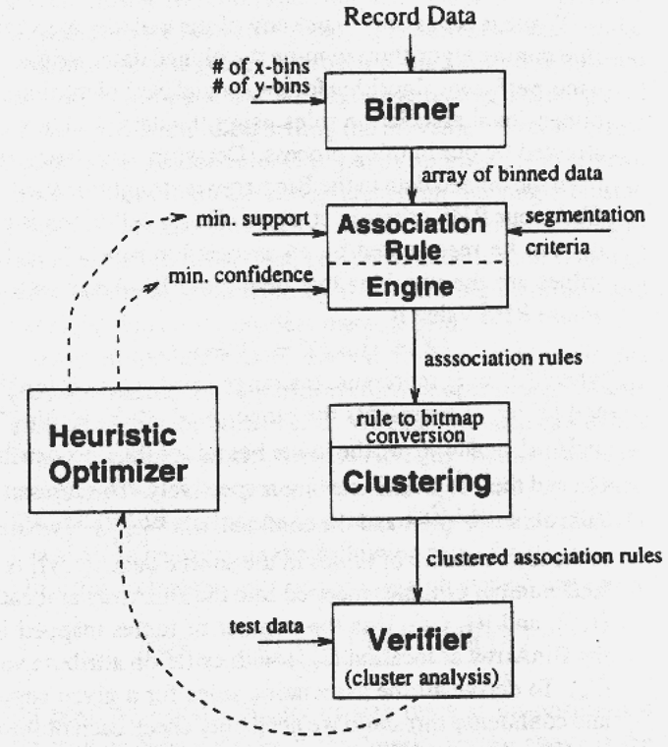
ARCS (Association Rule Clustering System)
How does ARCS work?
1. Binning
2. Find frequent predicateset
3. Clustering
4. Optimize
Data Mining: Concepts and Techniques

Slide 55
Limitations of ARCS
Only quantitative attributes on LHS of rules.
Only 2 attributes on LHS. (2D limitation)
An alternative to ARCS
  Non-grid-based
  equi-depth binning
  clustering based on a measure of partial completeness.
Data Mining: Concepts and Techniques

Slide 56
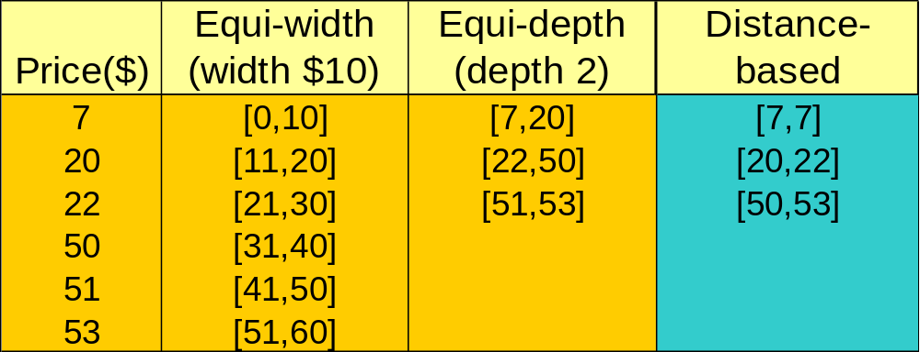
Mining Distance-based Association Rules
Binning methods do not capture the semantics of interval data
Distance-based partitioning, more meaningful discretization considering:
  density/number of points in an interval
  “closeness” of points in an interval
Data Mining: Concepts and Techniques

Slide 57
Mining Distance-based Association Rules
Equidepth partitioning -groups distant values together.
Equiwidth partitioning - split values that are close together and create intervals for which there is no data.
Distance based partitioning – considers the density or number of points in an interval,closeness of points in an interval.
Data Mining: Concepts and Techniques

Slide 58
Approximation in data values
Item_type(x,”electronic”)^ manufacturer(x,”foreign”) ⇒ price(X,$200)
Association rules don’t allow for approximation of attribute values. Support and confidence measures do not consider the closeness of values for a given attribute.
That is why distance based association rules are required.
Data Mining: Concepts and Techniques

Slide 59
Mining Distance-based Association Rules
A 2 phase algorithm is used to mine distance based association rules.
The first employs clustering to find the intervals or clusters.
The second phase obtains distance based association rules by searching for group of clusters that occur frequently together.
Example of distance based association rule
Cx ⇒ Cy
Data Mining: Concepts and Techniques

Slide 60
Mining Distance-based Association Rules
Ex. Cx cluster for age and Cy cluster for income.
When age clustered tuples Cx are projected onto the attribute income , their corresponding income values lie within the income cluster Cy or close to it.
The distance measures the degree of association between Cx and Cy. The smaller the distance stronger the association is.
Data Mining: Concepts and Techniques

Slide 61
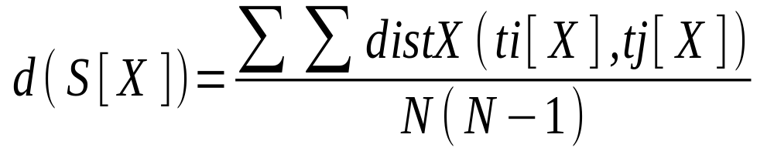
Clusters and Distance Measurements
S[X] is a set of N tuples t₁, t₂, …, t_{N} , projected on the attribute set X
The diameter of S[X]:
  dist_{x}:distance metric, e.g. Euclidean distance or Manhattan
Data Mining: Concepts and Techniques

Slide 62
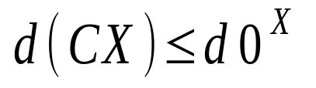
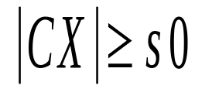
Clusters and Distance Measurements(Cont.)
The diameter, d, assesses the density of a cluster C_{X} , where
Finding clusters and distance-based rules
  the density threshold, d₀ , replaces the notion of support
  modified version of the BIRCH clustering algorithm
Data Mining: Concepts and Techniques

Slide 63
Chapter 6: Mining Association Rules in Large Databases
Association rule mining
Mining single-dimensional Boolean association rules from transactional databases
Mining multilevel association rules from transactional databases
Mining multidimensional association rules from transactional databases and data warehouse
From association mining to correlation analysis
Constraint-based association mining
Summary
Data Mining: Concepts and Techniques

Slide 64
Interestingness Measurements
Objective measures
  Two popular measurements:
  support; and
  confidence
Subjective measures (Silberschatz & Tuzhilin, KDD95)
  A rule (pattern) is interesting if
  it is unexpected (surprising to the user); and/or
  actionable (the user can do something with it)
Data Mining: Concepts and Techniques

Slide 65
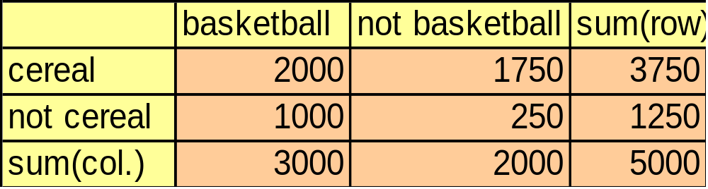
Criticism to Support and Confidence
Example 1: (Aggarwal & Yu, PODS98)
  Among 5000 students
    3000 play basketball
    3750 eat cereal
    2000 both play basket ball and eat cereal
  play basketball ⇒ eat cereal [40%, 66.7%] is misleading because the overall percentage of students eating cereal is 75% which is higher than 66.7%.
  play basketball ⇒ not eat cereal [20%, 33.3%] is far more accurate, although with lower support and confidence
Data Mining: Concepts and Techniques

Slide 66
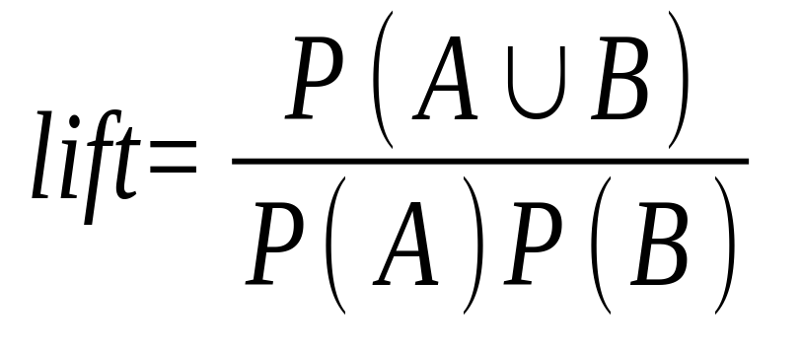
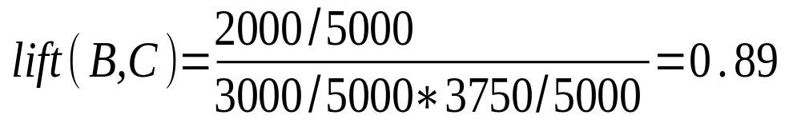
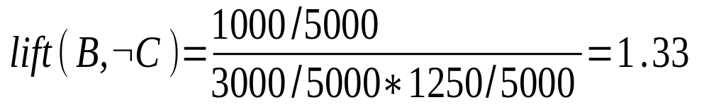
lift
Data Mining: Concepts and Techniques

Slide 67
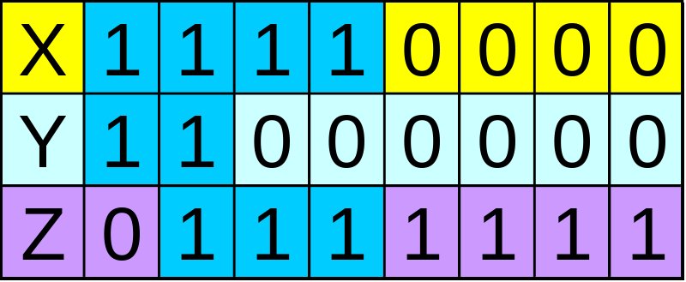
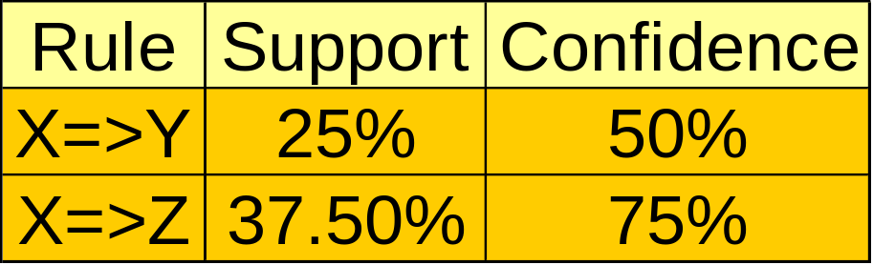
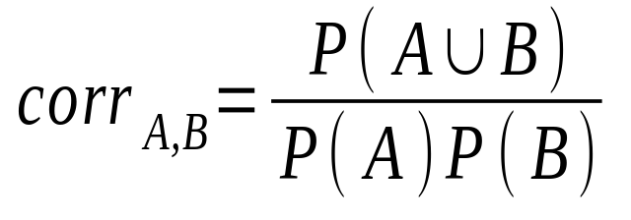
Criticism to Support and Confidence (Cont.)
Example 2:
  X and Y: positively correlated,
  X and Z, negatively related
  support and confidence of
  X=>Z dominates
We need a measure of dependent or correlated events
Data Mining: Concepts and Techniques

Slide 68
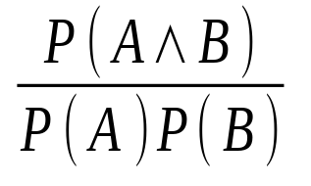
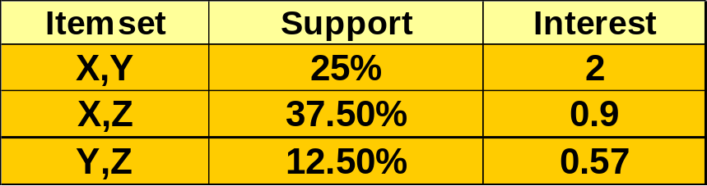
Other Interestingness Measures: Interest
Interest (correlation, lift)
  taking both P(A) and P(B) in consideration
  P(A^B)=P(B)*P(A), if A and B are independent events
  A and B negatively correlated, if the value is less than 1; otherwise A and B positively correlated
Data Mining: Concepts and Techniques

Slide 69
Chapter 6: Mining Association Rules in Large Databases
Association rule mining
Mining single-dimensional Boolean association rules from transactional databases
Mining multilevel association rules from transactional databases
Mining multidimensional association rules from transactional databases and data warehouse
From association mining to correlation analysis
Constraint-based association mining
Summary
Data Mining: Concepts and Techniques

Slide 70
Constraint-Based Mining
Interactive, exploratory mining giga-bytes of data?
  Could it be real? — Making good use of constraints!
What kinds of constraints can be used in mining?
  Knowledge type constraint: classification, association, etc.
  Data constraint: SQL-like queries
    Find product pairs sold together in Vancouver in Dec.’98.
  Dimension/level constraints:
    in relevance to region, price, brand, customer category.
  Rule constraints
    small sales (price < $10) triggers big sales (sum > $200).
  Interestingness constraints:
    strong rules (min_support ≥ 3%, min_confidence ≥ 60%).
Data Mining: Concepts and Techniques

Slide 71
Rule Constraints in Association Mining
Two kind of rule constraints:
  Rule form constraints: meta-rule guided mining.
    P(x, y) ^ Q(x, w) → takes(x, “database systems”).
  Rule (content) constraint: constraint-based query optimization.
    sum(LHS) < 100 ^ min(LHS) > 20 ^ count(LHS) > 3 ^ sum(RHS) > 1000
1-variable vs. 2-variable constraints:
  1-var: A constraint confining only one side (L/R) of the rule, e.g., as shown above.
  2-var: A constraint confining both sides (L and R).
    sum(LHS) < min(RHS) ^ max(RHS) < 5* sum(LHS)
Data Mining: Concepts and Techniques

Slide 72
Constrain-Based Association Query
Database: (1) trans (TID, Itemset ), (2) itemInfo (Item, Type, Price)
A constrained asso. query (CAQ) is in the form of {(S1, S2 )|C },
  where C is a set of constraints on S1, S2 including frequency constraint
A classification of (single-variable) constraints:
  Class constraint: S ⊂ A. e.g. S ⊂ Item
  Domain constraint:
    Sθ v, θ ∈ { =, ≠, <, ≤, >, ≥ }. e.g. S.Price < 100
    vθ S, θ is ∈ or ∉. e.g. snacks ∉ S.Type
    Vθ S, or Sθ V, θ ∈ { ⊆, ⊂, ⊄, =, ≠ }
      e.g. {snacks, sodas } ⊆ S.Type
  Aggregation constraint: agg(S) θ v, where agg is in {min, max, sum, count, avg}, and θ ∈ { =, ≠, <, ≤, >, ≥ }.
    e.g. count(S1.Type) = 1 , avg(S2.Price) < 100
Data Mining: Concepts and Techniques

Slide 73
Constrained Association Query Optimization Problem
Given a CAQ = { (S1, S2) | C }, the algorithm should be :
  sound: It only finds frequent sets that satisfy the given constraints C
  complete: All frequent sets satisfy the given constraints C are found
A naïve solution:
  Apply Apriori for finding all frequent sets, and then to test them for constraint satisfaction one by one.
Our approach:
  Comprehensive analysis of the properties of constraints and try to push them as deeply as possible inside the frequent set computation.
Data Mining: Concepts and Techniques

Slide 74
Anti-monotone and Monotone Constraints
A constraint C_{a} is anti-monotone iff. for any pattern S not satisfying C_{a}, none of the super-patterns of S can satisfy C_{a}
A constraint C_{m} is monotone iff. for any pattern S satisfying C_{m}, every super-pattern of S also satisfies it
Data Mining: Concepts and Techniques

Slide 75
Succinct Constraint
A subset of item I_{s} is a succinct set, if it can be expressed as σ_{p}(I) for some selection predicate p, where σ is a selection operator
SP⊆2^{I} is a succinct power set, if there is a fixed number of succinct set I₁, …, I_{k} ⊆I, s.t. SP can be expressed in terms of the strict power sets of I₁, …, I_{k} using union and minus
A constraint C_{s} is succinct provided SAT_{Cs}(I) is a succinct power set
Data Mining: Concepts and Techniques

Slide 76
Convertible Constraint
Suppose all items in patterns are listed in a total order R
A constraint C is convertible anti-monotone iff a pattern S satisfying the constraint implies that each suffix of S w.r.t. R also satisfies C
A constraint C is convertible monotone iff a pattern S satisfying the constraint implies that each pattern of which S is a suffix w.r.t. R also satisfies C
Data Mining: Concepts and Techniques

Slide 77
Relationships Among Categories of Constraints
Succinctness
Anti-monotonicity
Monotonicity
Convertible constraints
Inconvertible constraints
Data Mining: Concepts and Techniques

